Slide 1
MODULE 6 HYBRID SYSTEMS

Slide 2
Hybrid Systems
A Hybrid system is an intelligent system which is framed by combining at least two intelligent technologies like Fuzzy Logic, Neural networks, Genetic algorithm, reinforcement Learning, etc.
The combination of different techniques in one computational model make these systems possess an extended range of capabilities.
These systems are capable of reasoning and learning in an uncertain and imprecise environment.
These systems can provide human-like expertise like domain knowledge, adaptation in noisy environment etc.

Slide 3
Hybrid Systems
While NN are good at recognizing the patterns, they are not good at explaining how they reach their decisions.
Fuzzy logic systems, which can reason with imprecise information, are good at explaining their decisions but they can’t automatically acquire the rules they use to make those decisions.
GA are just effective search & Optimization techniques.
These limitations have been a central driving force behind the creation of intelligent hybrid systems.

Slide 4
Hybrid Systems
Types of Hybrid Systems:
Neuro Fuzzy Hybrid Systems
Neuro Genetic Hybrid Systems
Fuzzy Genetic Hybrid Systems

Slide 5
Neuro Fuzzy Hybrid Systems
It is based on fuzzy system which is trained on the basis of working of neural network theory.
The learning process operates only on the local information and causes only local changes in the underlying fuzzy system.
A neuro-fuzzy system can be seen as a 3-layer feedforward neural network.
The first layer represents input variables, the middle (hidden) layer represents fuzzy rules and the third layer represents output variables.
Fuzzy sets are encoded as connection weights within the layers of the network, which provides functionality in processing and training the model.

Slide 6
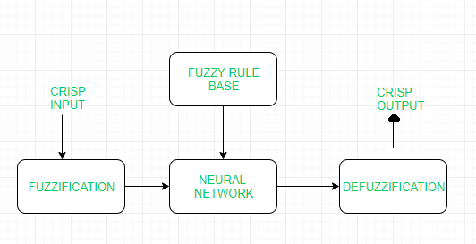
Working Flow:
In input layer, each neuron transmits external crisp signals directly to the next layer.
Each fuzzification neuron receives a crisp input and determines the degree to which the input belongs to input fuzzy set.
Fuzzy rule layer receives neurons that represent fuzzy sets.
An output neuron, combines all inputs using fuzzy operation UNION.
Each defuzzification neuron represents single output of neuro-fuzzy system.

Slide 7
Advantages:
It can handle numeric, linguistic, logic, etc kind of information.
It can manage imprecise, partial, vague or imperfect information.
It can resolve conflicts by collaboration and aggregation.
It has self-learning, self-organizing and self-tuning capabilities.
It can mimic human decision-making process.
Disadvantages:
Hard to develop a model from a fuzzy system
Problems of finding suitable membership values for fuzzy systems
Neural networks cannot be used if training data is not available.
Applications:
Student Modelling
Medical Systems
Traffic Control Systems
Forecasting and Predictions

Slide 8
Neuro Genetic Hybrid Systems
A Neuro Genetic hybrid system is a system that combines Neural networks: which are capable to learn various tasks from examples, classify objects and establish relation between them and Genetic algorithm: which serves important search and optimization techniques.
Genetic algorithms can be used to improve the performance of Neural Networks and they can be used to decide the connection weights of the inputs.
These algorithms can also be used for topology selection and training network.

Slide 9
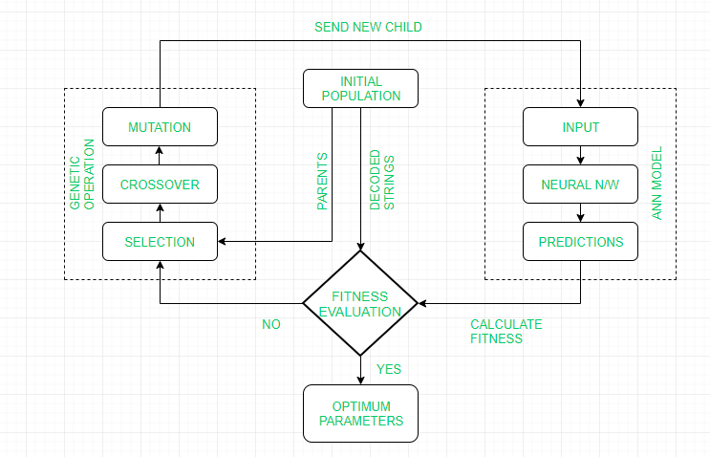

Slide 10
Working Flow:
GA repeatedly modifies a population of individual solutions. GA uses three main types of rules at each step to create the next generation from the current population:
Selection to select the individuals, called parents, that contribute to the population at the next generation
Crossover to combine two parents to form children for the next generation
Mutation to apply random changes to individual parents in order to form children
GA then sends the new child generation to ANN model as new input parameter.
Finally, calculating of the fitness by developed ANN model is performed.

Slide 11
Advantages:
GA is used for topology optimization i.e to select number of hidden layers, number of hidden nodes and interconnection pattern for ANN.
In GAs, the learning of ANN is formulated as a weight optimization problem, usually using the inverse mean squared error as a fitness measure.
Control parameters such as learning rate, momentum rate, tolerance level, etc are also optimized using GA.
It can mimic human decision-making process.
Disadvantages:
Highly complex system.
Accuracy of the system is dependent on the initial population.
Maintainance costs are very high.
Applications:
Face recognition
DNA matching
Animal and human research
Behavioral system

Slide 12
Fuzzy Genetic Hybrid Systems
A Fuzzy Genetic Hybrid System is developed to use fuzzy logic based techniques for improving and modelling Genetic algorithms and vice-versa.
Genetic algorithm has proved to be a robust and efficient tool to perform tasks like generation of fuzzy rule base, generation of membership function etc.
Three approaches that can be used to develop such system are:
Michigan Approach
Pittsburgh Approach
IRL Approach

Slide 13
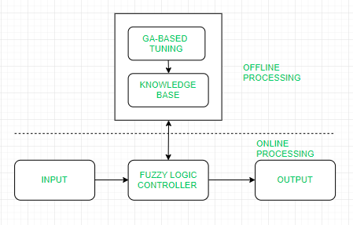
Working Flow:
Start with an initial population of solutions that represent first generation.
Feed each chromosome from the population into the Fuzzy logic controller and compute performance index.
Create new generation using evolution operators till some condition is met.

Slide 14
Advantages:
GAs are used to develop the best set of rules to be used by a fuzzy inference engine
GAs are used to optimize the choice of membership functions.
A Fuzzy GA is a directed random search over all discrete fuzzy subsets.
It can mimic human decision-making process.
Disadvantages:
Interpretation of results is difficult.
Difficult to build membership values and rules.
Takes lots of time to converge.
Applications:
Mechanical Engineering
Electrical Engine
Artificial Intelligence
Economics

